Slide 1
Chemical Changes

Slide 2
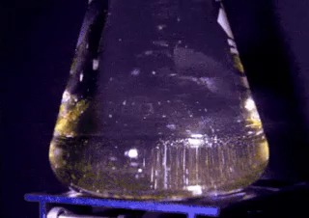
By the end of this lesson, you should be able to:
Explain how a chemical change can alter a substance.
State the different ways that a chemical change can be detected.

Slide 3
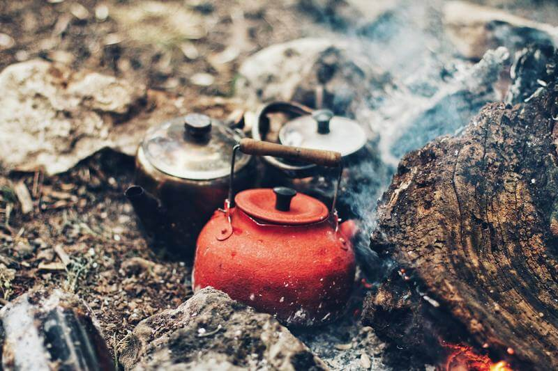
A pot of water is boiling on a fire.
There are two changes happening here: The water is boiling, and the fuel of the fire is burning.
We already know that the boiling water is a physical change. It is changing state, from a liquid to a gas. But what is the fire doing?

Slide 4
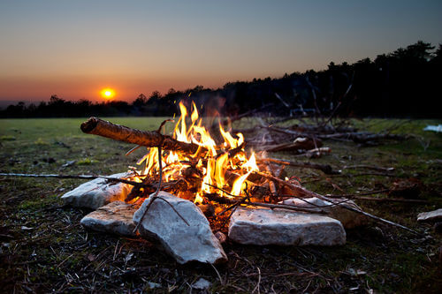
A fire takes one substance, and turns it into several different substances.
The ash and smoke from a wood fire are not the same as the wood that was burning.
A fire is a chemical change, because it changes one substance into another substance.

Slide 5
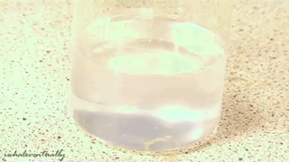
Chemical changes involve changes to the chemical inside a substance.
This can happen through making new molecules, new compounds, or just rearranging the atoms to be structured differently.
A physical change makes substances appear differently, but chemical changes make them actually different.

Slide 6
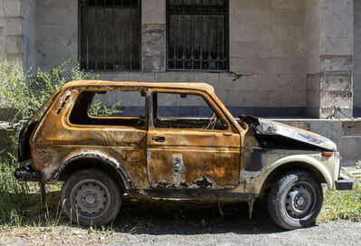
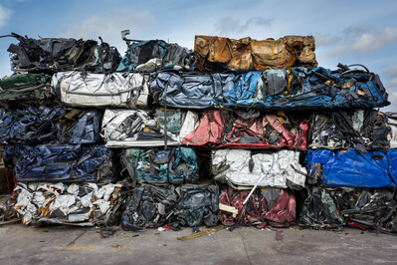
The final substance has to be chemically different to the starting substances to make a chemical change.
For example, if a car is rusting, this is a chemical change, because the iron of the car body is changing into rust.
If a car is being crushed, this is not a chemical change, because the iron is still iron. It's just smaller.

Slide 7
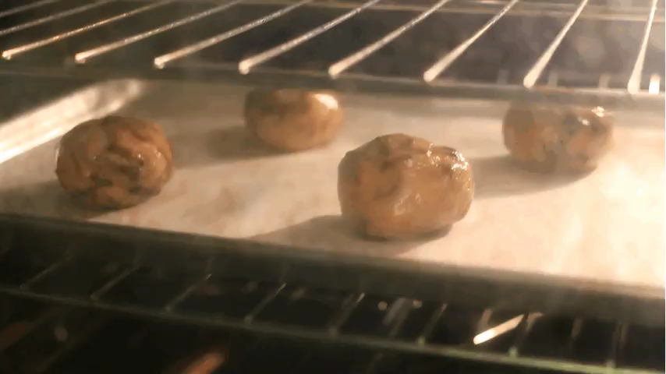
A chemical change cannot be reversed by physical means, and often cannot be reversed at all.
For example, if you bake a cookie (a chemical change), the cookie cannot be un-baked. It would take extraordinary means to reverse this change.
This is different to physical changes, which are always reversible. If water is frozen or boiled, it can be melted or condensed to return to a liquid.

Slide 8
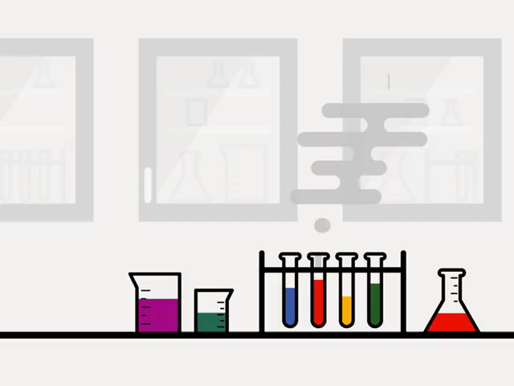
Chemical changes take place on the microscopic level, so we cannot observe them directly.
Instead, we have to look for the effects that chemical changes have on the changing substances.
Compared to a physical change, it can be much less obvious that a chemical change has occurred.

Slide 9
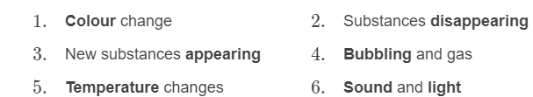
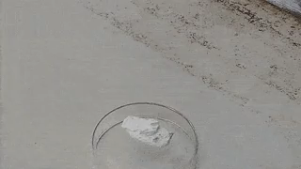
The most common ways that a chemical change can be identified include:

Slide 10
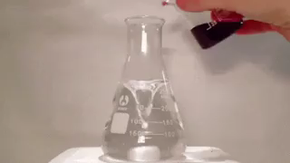
1) A colour change occurs.
Colour is determined by how light interacts with chemicals. Objects with different chemical structures can interact with light in different ways, so they can also have different colours.
Therefore, if the colour of a substance changes, it is very likely to have had a chemical change.

Slide 11
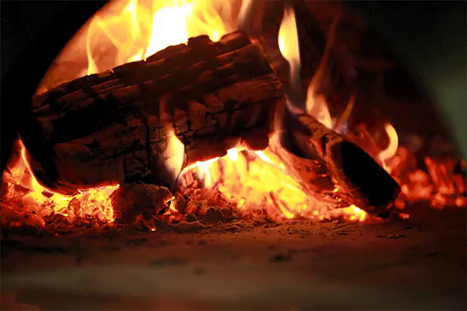
2) One or more of the substances disappears.
A piece of wood on fire will eventually disappear. In its place will be ash, and the smoke it produced while burning. This happens because the wood has changed into something else.
During a chemical change, the original substance is being converted into something else. We can see this as the substance disappears.

Slide 12
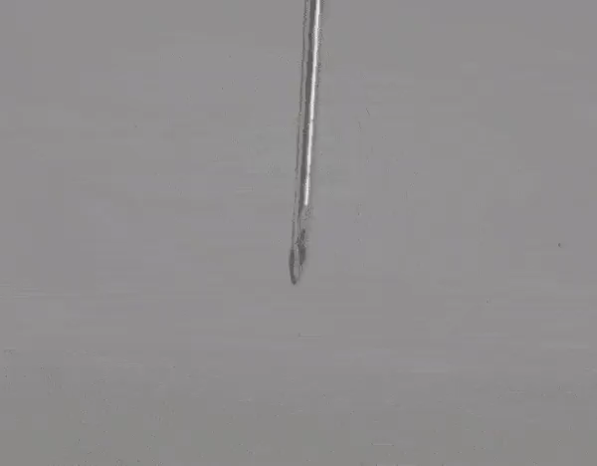
3) A solid is created.
This shows that a chemical change has occurred, because a product (the solid) has formed that was not there before. The substances have changed into something new.
If a solid is created from a reaction in a liquid solution, this is called a precipitate.

Slide 13
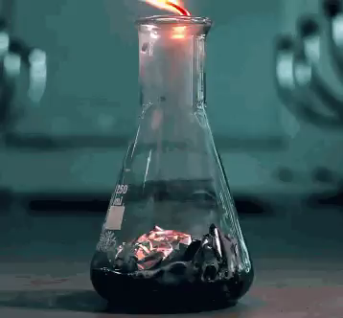
4) A gas is given off.
Gases are most easily seen as bubbling, because most gases are colourless.
If a gas is given off where there was no gas before, a chemical change is likely to be the cause.

Slide 14
5) The temperature of the reactants changes on its own.
Sometimes when a chemical change happens, heat is absorbed or released as the particles move about. This can change the temperature of the substances. Some changes will start to feel hot or cold on their own. If this happens, we can assume a chemical change is happening.

Slide 15

6) Sound or light is given off.
The reasons behind this are complex, but sometimes when a chemical change occurs, sound or light can be released.
Of these two, light is more common, but some reactions can release both. For example, the burning of hydrogen in oxygen causes an explosion, which will make both light and sound.

Slide 16
To summarise, these are the indicators to show that a chemical change has occurred:
1. | A colour change.
2. | The original substance disappears.
3. | A gas is given off (seen as bubbles or detected by smell).
4. | A solid forms.
5. | The temperature of the substance increases or decreases on its own.
6. | Sound or light is given off.

Slide 17
